Slide 1

Toy Swap - A Toy Rental Platform
A comprehensive toy rental platform with seamless rentals and CRM Management

Slide 2
Objective
The objective is to build a toy rental platform managing CRM, purchase, inventory and accounting which enhancing customer engagement, and ensuring end-to-end visibility across all touchpoints, from browsing and rentals to maintenance and financial tracking.

Slide 3

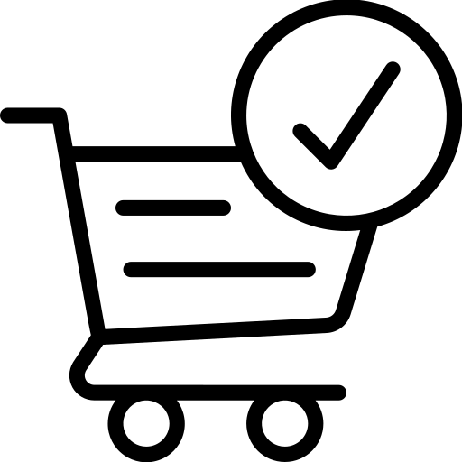
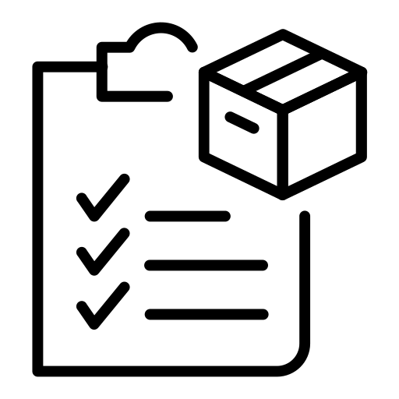
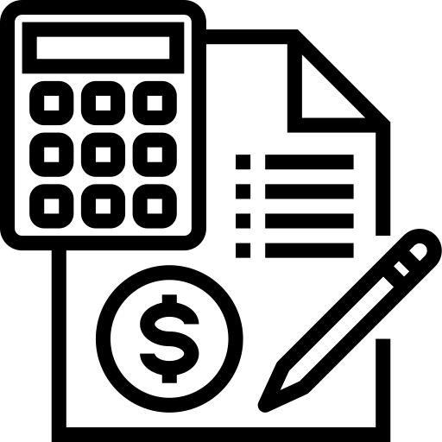
Key Module & Its Features
CRM Module
Purchase Module
Inventory Module
Accounting Module
Lead and Opportunity Management
Customer Profiles Management
Automated Follow-Ups (Email & SMS)
Supplier Management
Purchase Orders (PO)
Supplier Invoices
Purchases Analysis
Low Stock Alerts
Maintenance Tracking
Stock Alerts
Rental Reservation
Logistics
Dispatch
Return
Invoice and Billing
Revenue Recognition
Accounts Receivable
Financial Reporting

Slide 4

Exchange WorkFlow
Return Toy
Exchange Toy
Picks a new toy from catalog
Benefits:
Return and delivery in a single trip
Save time and cost
Customer’s Continuous Engagement
Delivery is arranged once return is completed

Slide 5

Governance & Delivery Process
2 Weekly sprint updates, monthly reviews
Zoom/Google chat communication
Monthly milestone review

Slide 6
CI/CD pipelines, disaster recovery
Full disaster recovery and code back-ups
Follow complete SDLC process in development.
Risk Management

Slide 7
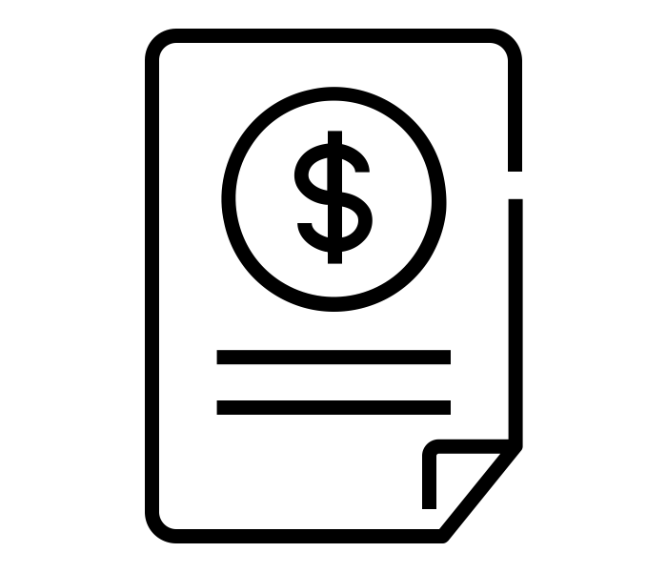
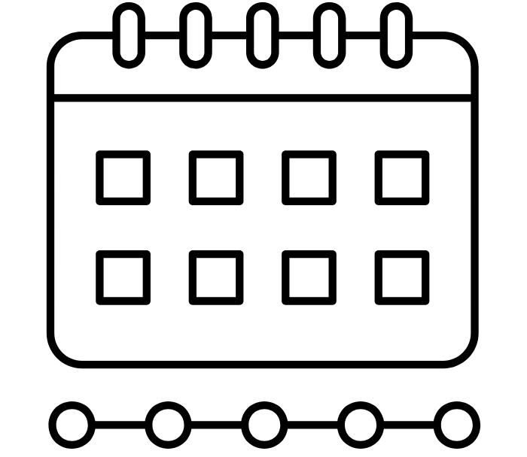
Project Costing & TimeLine
Costing
TimeLine
$ 17,000
3.5 Months

Slide 8
Thank You

